Slide 1
Image Super resolution
Youssef Mohamed abdelshahid 2022/05890

Slide 2


introduction
Need for high-quality images from low-resolution inputs.
Super-Resolution via Deep Learning.
Train and evaluate SRCNN on standard datasets.

Slide 3
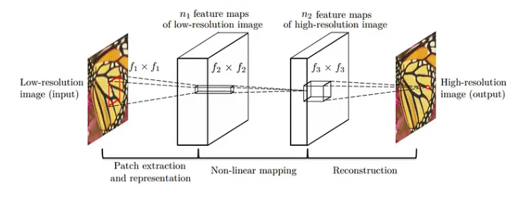
What is SRCNN?
3-layer CNN model.
Simple yet effective architecture.
Performs end-to-end image mapping.

Slide 4
What is fsrcnn?
Accelerated version of SRCNN with improved speed and performance.
Employs a deeper structure with shrinking and expanding layers.
Upsampling is performed at the end, enabling faster inference on low-resolution input.

Slide 5
What is edsr?
Deep residual network specifically designed for super-resolution.
Removes unnecessary batch normalization to improve performance.
Achieves state-of-the-art results with enhanced detail reconstruction.

Slide 6
preprocessing
Process: Downscale → Patch extraction → Normalization.
Training/Validation split.

Slide 7
Training details
Loss: Mean Squared Error (MSE)
Optimizer: Adam
Metrics: PSNR, SSIM
150 Epochs with early stopping, batch size of 16

Slide 8
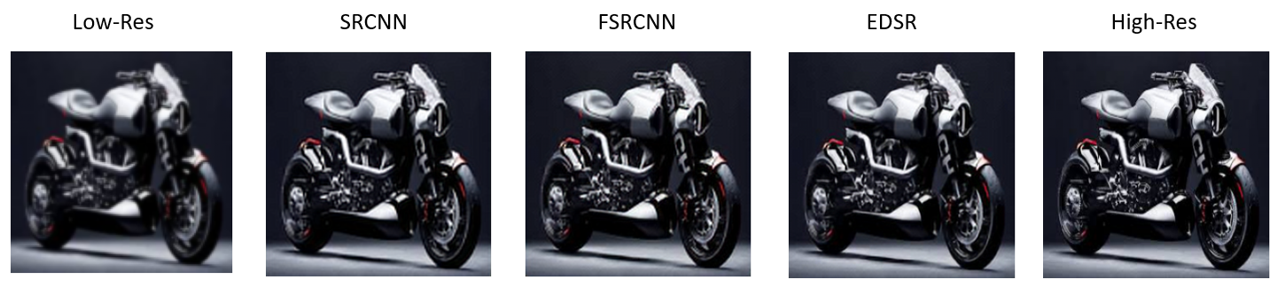
Visual Output Comparison

Slide 9
Model Comparison
Model | PSNR | Training time | Parameters | Notes
SRCNN | 30.40 | Fast | Low | Simple
FSRCNN | 30.70 | Faster | Low | Lightweight
VDSR | ~31.50 | Longer | Higher | Deeper
EDSR | 31.84 | Much Longer | Very High | Very Heavy
ESRGAN | ~33.00 | Very Long | Massive | GAN-based, produces visually appealing images but slow and complex

Slide 10
Strengths of SRCNN
Simple yet effective architecture (only 3 layers).
Low training cost.
Competitive performance with deeper models.
Suitable for real-time or mobile applications.

Slide 11
Conclusion
Implemented and compared three deep learning models: SRCNN, FSRCNN, and EDSR for image super-resolution.
SRCNN offered a solid baseline with a simple architecture and balanced performance.
FSRCNN improved speed and efficiency.
EDSR achieved the best visual and quantitative results, leveraging deep residual learning.
Overall, the project demonstrated the trade-offs between speed, complexity, and output quality across different architectures.

